Slide 1
Data Analysis I: Simple Model Application
Introduction to Data Science
efl Data Science Course
Dr. Jens Lausen
Notes:
DAta set: https://www.kaggle.com/wendykan/lending-club-loan-data

Slide 2
Step 4 – Model the data
Ask an interesting question.
How do we compute the interest rate automatically from a given datapoint?
What is the data we need to train a debt-class-classifier?
Get the data.
We got the data from our firm.
No privacy problems.
Let‘s go and explore!
Explore the data.
Plot the data.
Are there anomalies?
Are there patterns?
Model the data.
Build a model.
Fit the model.
Validate the model.
Communicate and visualize the results.
What did we learn?
Do the results make sense?
Can we tell a story?
2

Slide 3
What is a model?
All possible manifestations of the data
„explains“
available data
model
Notes:
Modell: Abbild der Realität
-> Nur relevante Parameter werden betrachtet, um einen bestimmten Nutzen zu erfüllen -> idR um ein bestimmtes Phänomen zu erklären
-> Auf Basis der beobachtungen die wir haben, versuchen wir die Realität zu erklären

Slide 4
How do we model data / learn from data?
Example machine learning: supervised learning vs. unsupervised learning
Unsupervised Learning: The data has no target attribute
We want to explore the data to find some intrinsic structures in it
Supervised Learning: Discover patterns in the data that relate data attributes with a target (class) attribute
These patterns are then utilized to predict the values of the target attribute in future data instances

Slide 5
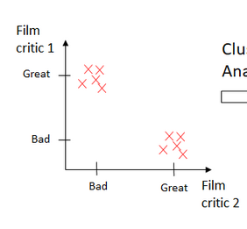
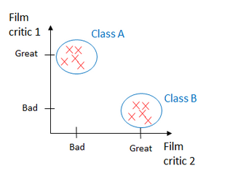

Unsupervised Learning Example: Clustering
No target value
Goal: Identify associations, i.e. grouping data (to previously unknown classes)
Applications:
Anomaly detection
Recommending systems
Documents grouping
Finding customers with common interests
Example
Imagine we have a dataset of movies and want to classify them. We have the following reviews of films.
The machine learning model will infer that there are two different classes without knowing anything else from the data
Source: https://towardsdatascience.com/unsupervised-machine-learning-clustering-analysis-d40f2b34ae7e

Slide 6
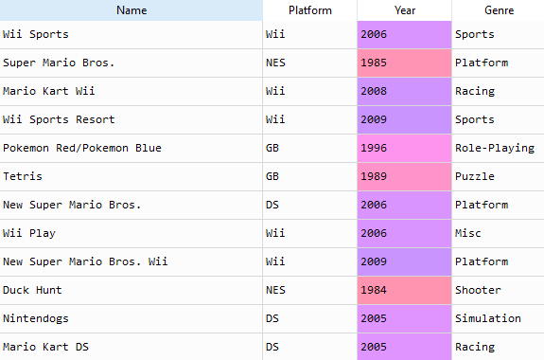

Supervised Learning Example 1: Classification
Target value is categorial (a set of known classes), e.g. the genre of a video game
Goal: Train a model that detects patterns in the data in order to assign observations to one of theses classes
Example
Find the genre of a game based on its name
Genres
Games
→ Games having the word „Kart“ in their name are highly likely to be in the „Racing“ genre

Slide 7
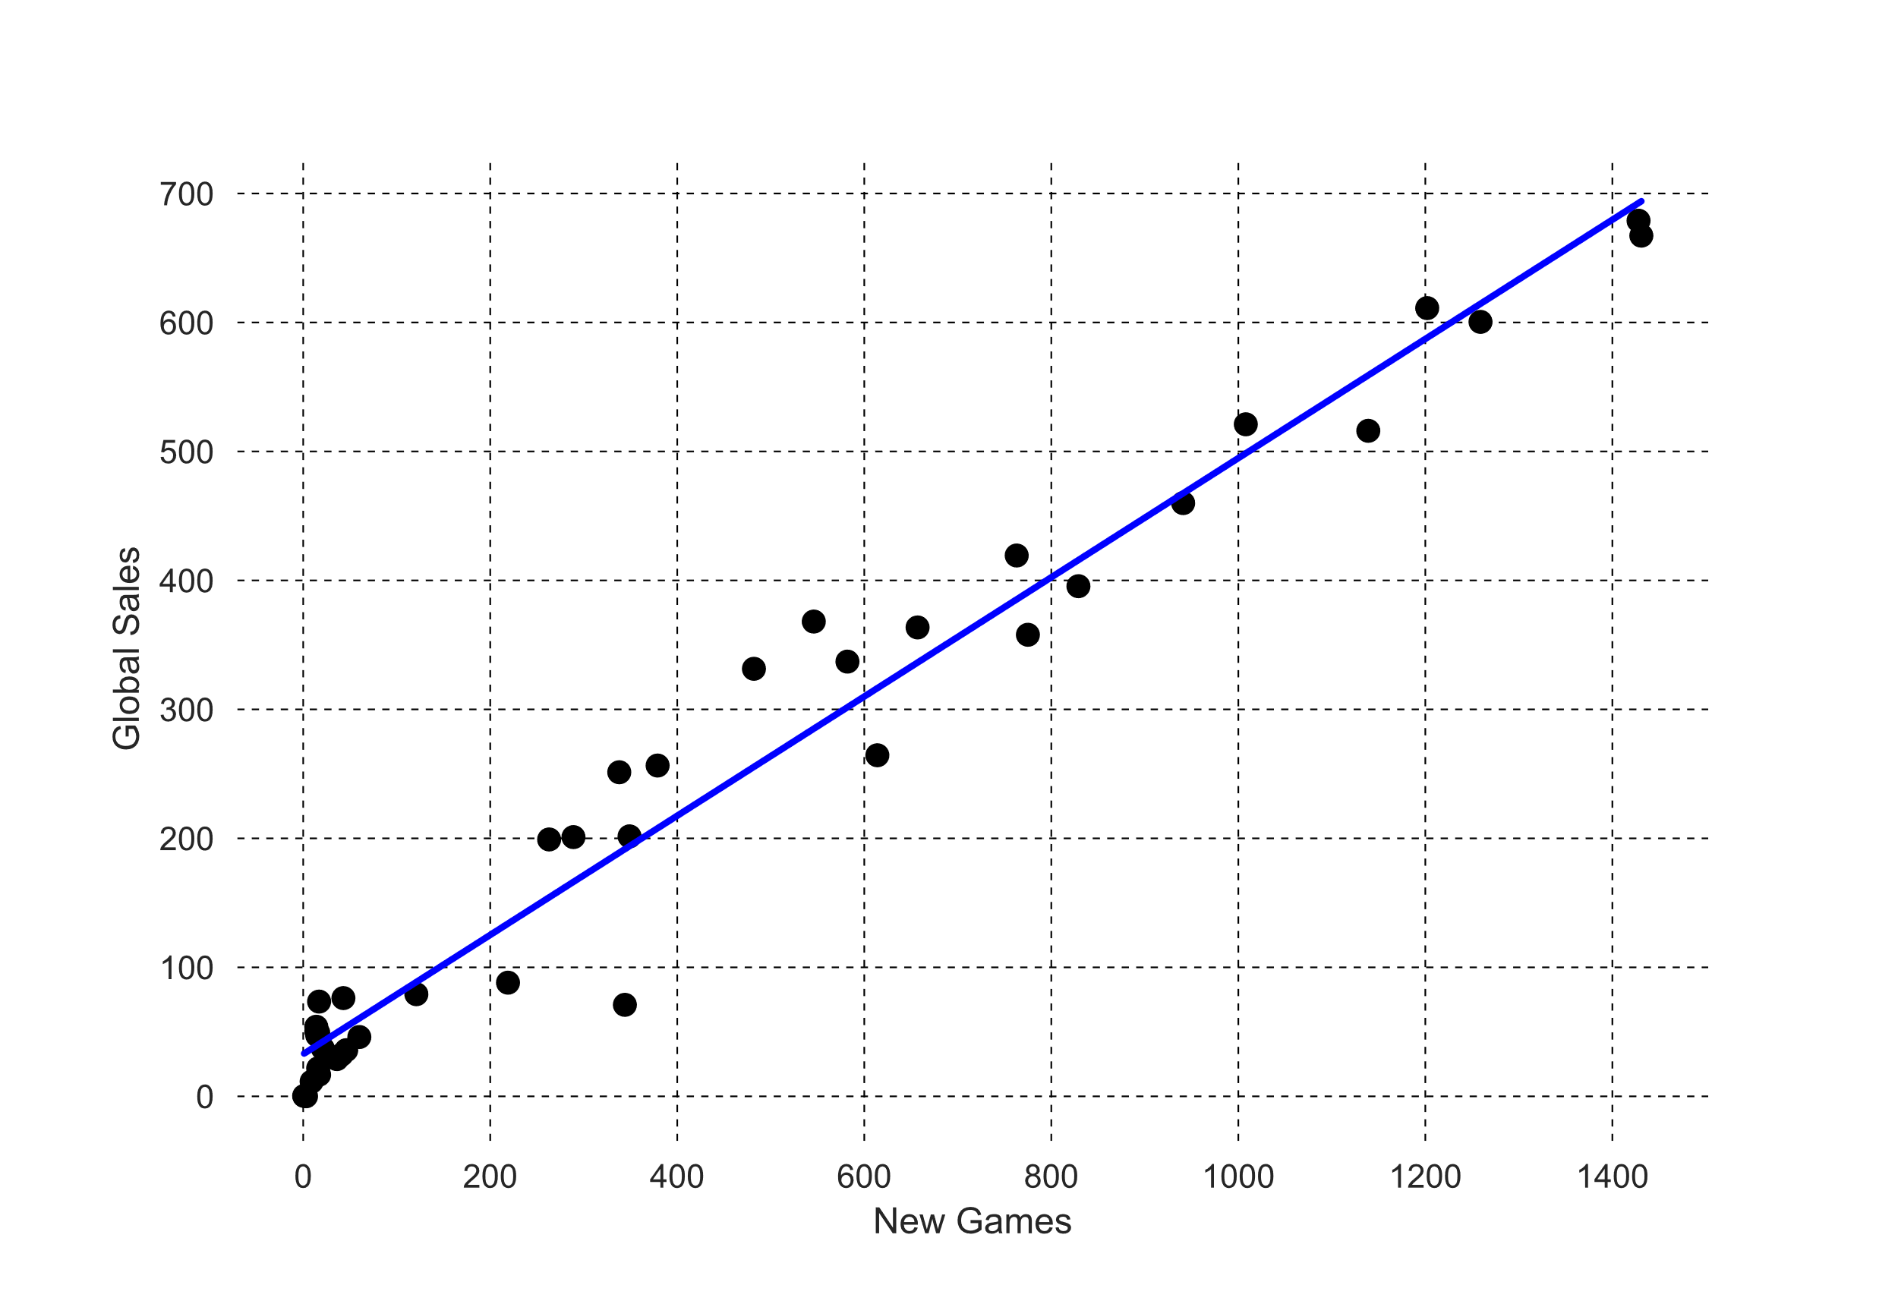
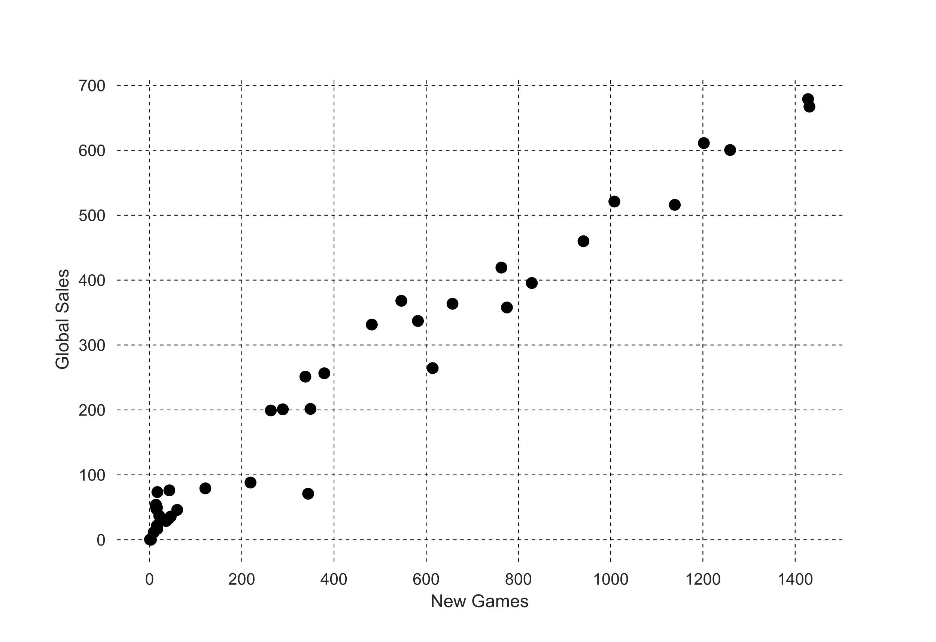
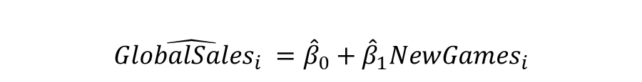
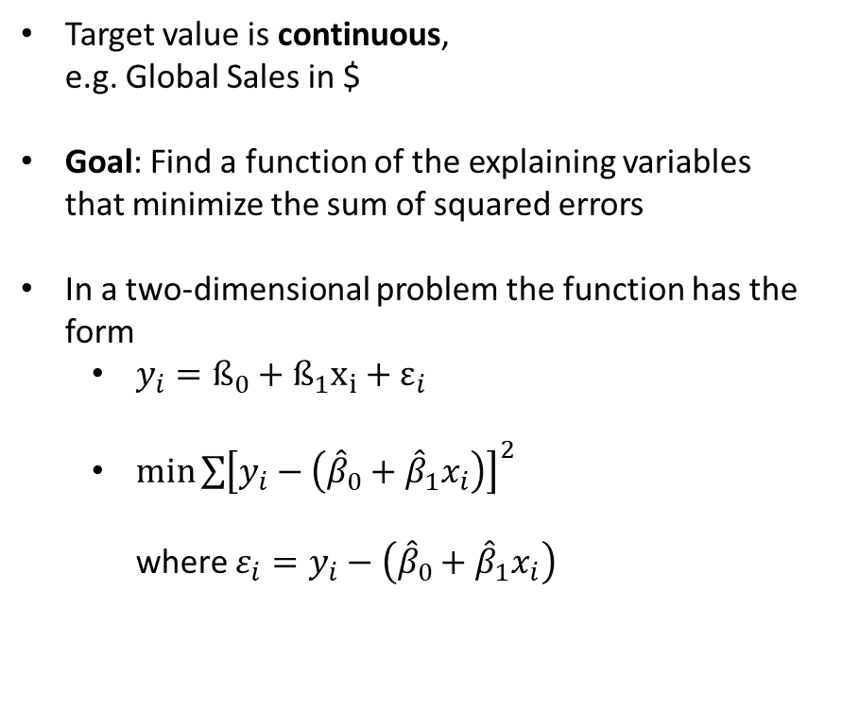
Supervised Learning Example 2: Regression
Target value is continuous, e.g. Global Sales in $
Goal: Find a function of the explaining variables that minimize the sum of squared errors
In a two-dimensional problem the function has the form
$y_{i}=ß_{0}+ß_{1}x_{i}+ε_{i}$
$\min{\sum{{\left[y_{i}−\left({\hat{β}}_{0}+{\hat{β}}_{1}x_{i}\right)\right]}^{2}}}$ where $ε_{i}=y_{i}−\left({\hat{β}}_{0}+{\hat{β}}_{1}x_{i}\right)$
Example
Explain the global video game sales in a year with the number of new game realeases in a year
$$\hat{GlobalSales_{i} }={\hat{β}}_{0}+{\hat{β}}_{1}{NewGames}_{i}$$

Slide 8
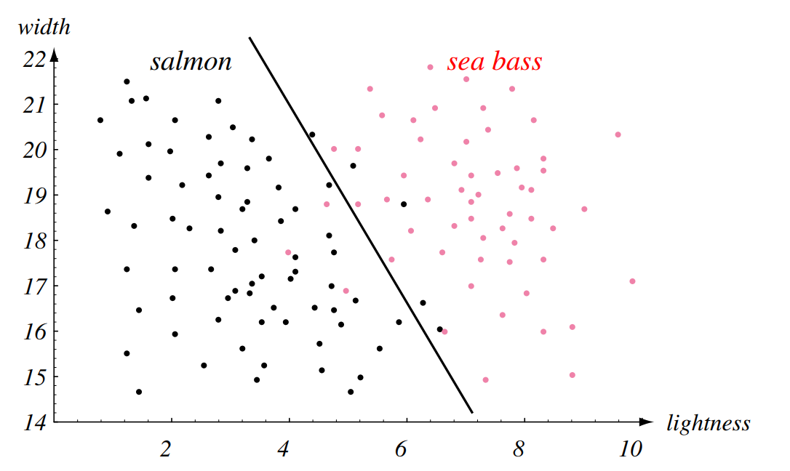
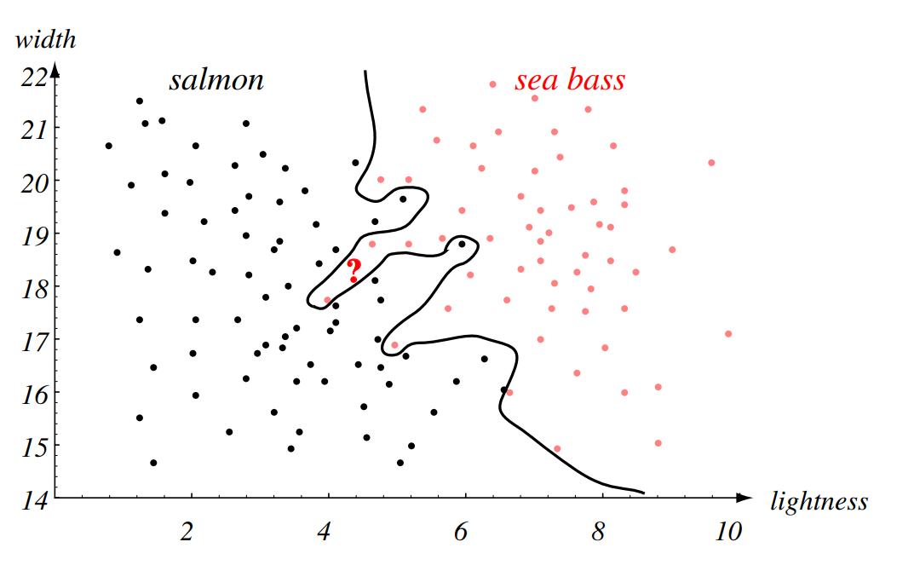
Problems with modelling: Overfitting
Linear classification
Overfitted model
Overfitting? So what?! my model performs good on my data!
Yet, the produced model corresponds too closely to the training set and may therefore fail to fit unseen data or predict future observations reliably → We want a generalizing model!
Source: J. M. Buhmann – Lectures on Machine Learning

Slide 9
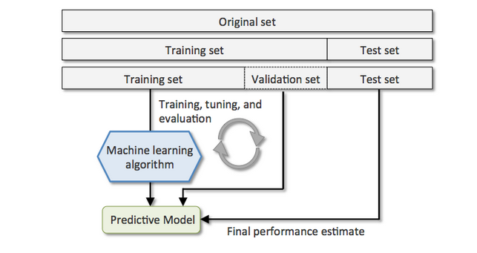
How to overcome problems of overfitting?
Train: we train the model
Validation: we validate and adjust model parameters
Test: unseen data. We get an unbiased final estimate
Source: https://stats.stackexchange.com/questions/410118/cross-validation-vs-train-validation-test

Slide 10
Recap and what this session is about
You learnt how to read, preprocess, and describe data using visualizations and summary statistics
This session: First simple model application
Decision Trees are popular non-parametric supervised learning techniques for regression and classification problems which are able to handle complex relations within data in an accessible and interpretable way
Random Forests overcome problems of Decision Trees with relatively little extra work by growing a set of roughly independent tree models
Notes:
A Non-parametric method means that there are no underlying assumptions about the distribution of the errors or the data. It basically means that the model is constructed based on the observed data.

Slide 11
Table of Contents
Decision Trees
Random Forests

Slide 12
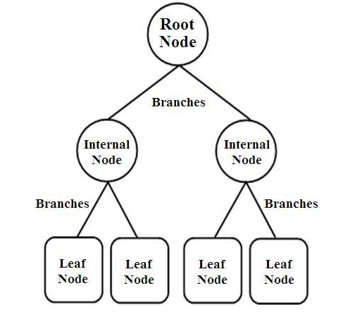
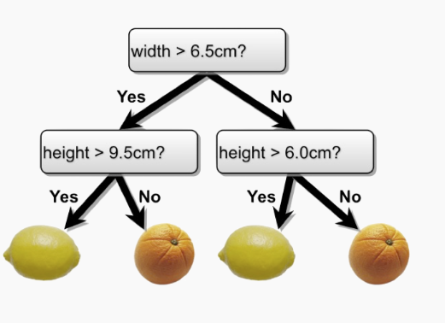
What is a decision tree?
General Structure of a Decision Tree
Example of a Classification Tree

Slide 13
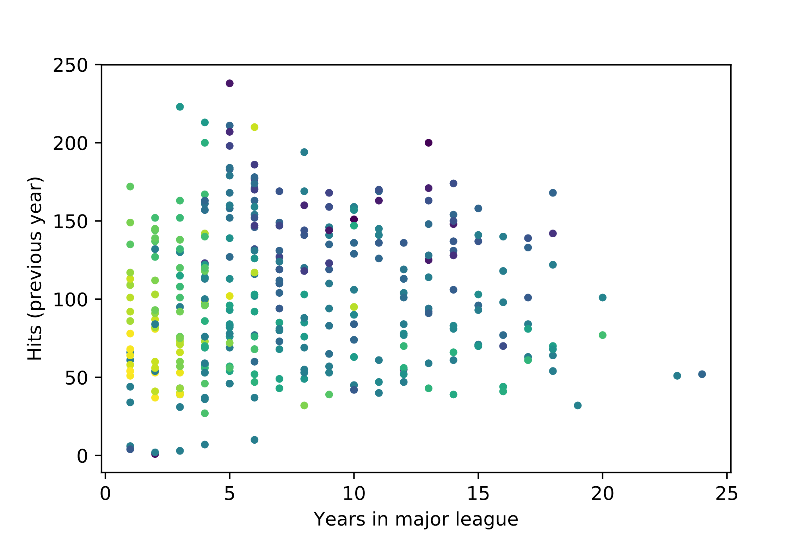

Introductory example and problem formulation
Example data set:
Major League Baseball Data from the 1986 and 1987 seasons
322 observations of major league players
The color indicates the amount of salary (The darker the higher)
Split here?
Salary
Goal:
Predict the salary of major league players in 1987 based on
Number of years in the major leagues
Number of hits in 1986
Split here?
General goal of a Decision Tree:
Find binary splits in the data
Minimize overall error
General learning algorithm of a Decision Tree:
Start with empty decision tree (undivided feature space)
Choose optimal predictor on which to split and choose the optimal threshold value for splitting by applying a splitting criterion
Recurse on on each new node until stopping condition (e.g. maximum depth) is met
Notes:
Hits in baseball are when a player sucessfully hits the ball and reaches a base

Slide 14

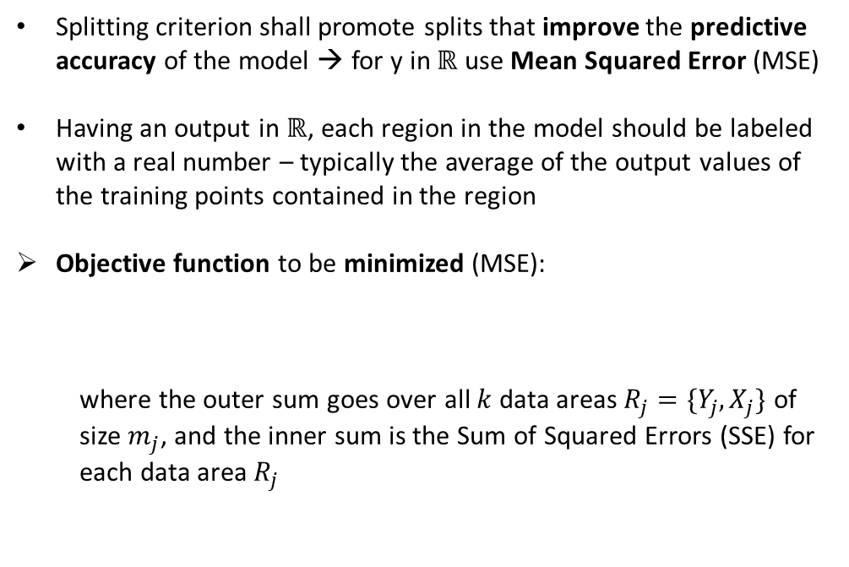

The concept of the Regression Tree
Splitting criterion shall promote splits that improve the predictive accuracy of the model → for y in $ℝ$ use Mean Squared Error (MSE)
Having an output in $ℝ$, each region in the model should be labeled with a real number – typically the average of the output values of the training points contained in the region
Objective function to be minimized (MSE):
where the outer sum goes over all $k$ data areas $R_{j}=\{Y_{j}, X_{j}\}$ of size $m_{j}$, and the inner sum is the Sum of Squared Errors (SSE) for each data area $R_{j}$
Salary
$$R_{1}$$
$$R_{2}$$
Notes:
https://harvard-iacs.github.io/2017-CS109A/lectures/lecture15/presentation/lecture15_RandomForest.pdf
RSS = Residual sum of squares = sum of squared errors (SSE)

Slide 15
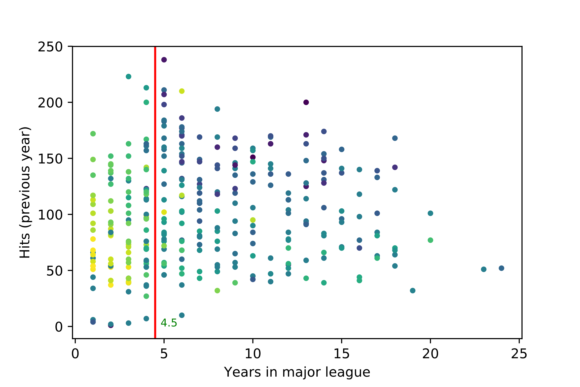
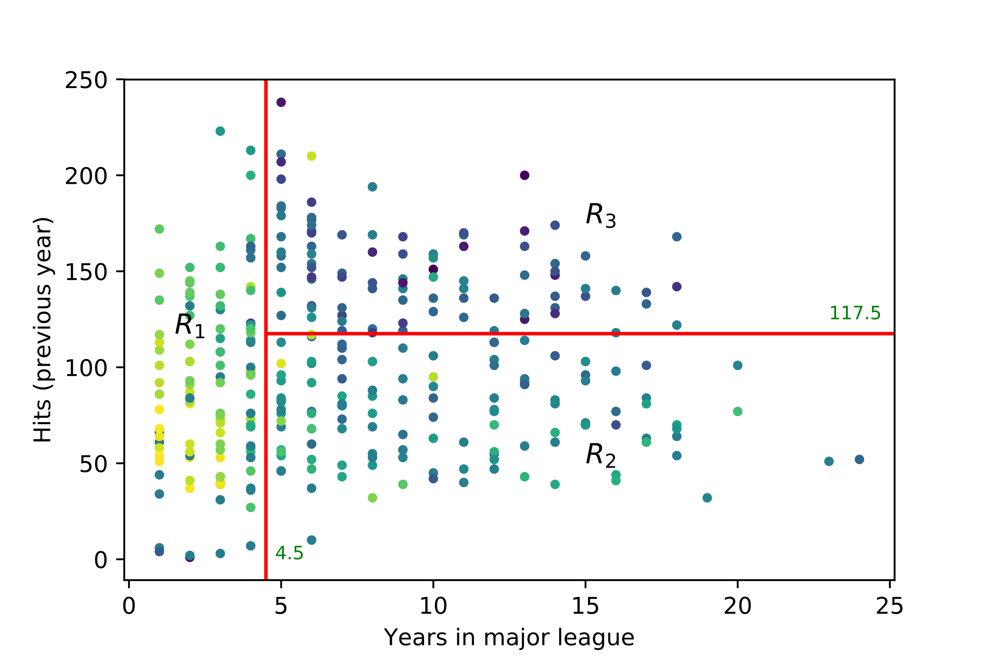
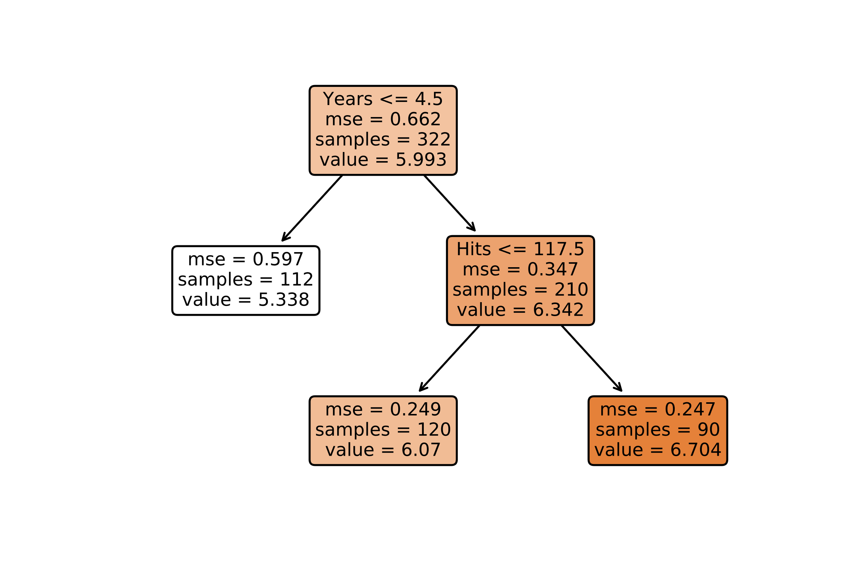
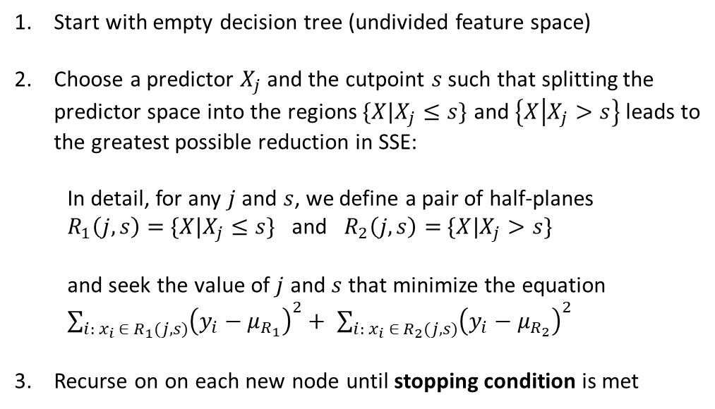
Learning algorithm of a Regression Tree
Salary
Start with empty decision tree (undivided feature space)
Choose a predictor $X_{j}$ and the cutpoint $s$ such that splitting the predictor space into the regions $\{X|X_{j}≤s\}$ and $\left\{X | X_{j}>s\right\}$leads to the greatest possible reduction in SSE:
In detail, for any $j$ and $s$, we define a pair of half-planes
$R_{1}\left(j,s\right)=$ $\{X|X_{j}≤s\}$ and $R_{2}\left(j,s\right)=$ $\{X|X_{j}>s\}$
and seek the value of $j$ and $s$ that minimize the equation
$\sum_{i:{ x}_{i} ∈{ R}_{1}(j,s)}{{\left(y_{i}−μ_{R_{1}}\right)}^{2}+ }$ $\sum_{i:{ x}_{i} ∈{ R}_{2}(j,s)}{{\left(y_{i}−μ_{R_{2}}\right)}^{2} }$
Recurse on on each new node until stopping condition is met

Slide 16
Stopping conditions for Regression Trees
Stopping conditions
Max depth – the maximum depth of the tree
Accuracy gain - Further splits give less than some minimal amount of extra information
Further splits would results in nodes containing less than a certain percentage of the total data
Notes:
https://harvard-iacs.github.io/2017-CS109A/lectures/lecture15/presentation/lecture15_RandomForest.pdf

Slide 17
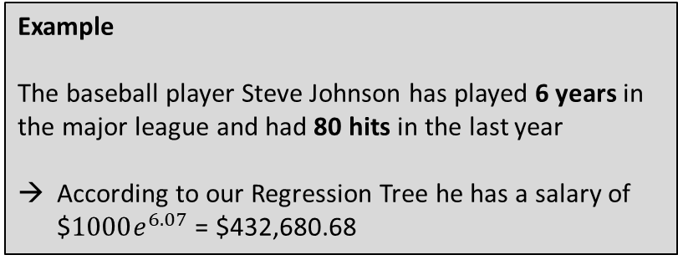
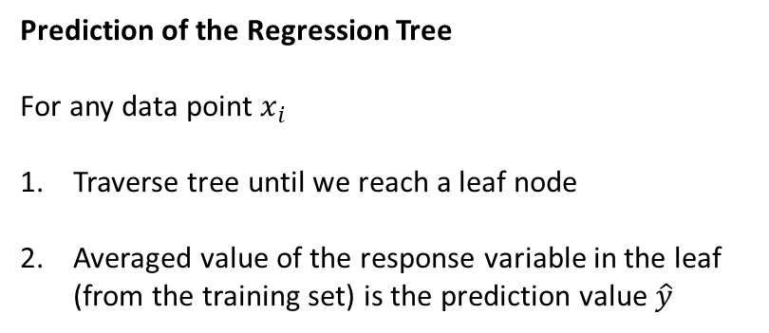
Using the Regression Tree for prediction
Prediction of the Regression Tree
For any data point $x_{i}$
Traverse tree until we reach a leaf node
Averaged value of the response variable in the leaf (from the training set) is the prediction value $\hat{y}$
Example
The baseball player Steve Johnson has played 6 years in the major league and had 80 hits in the last year
According to our Regression Tree he has a salary of $$1000e^{6.07}$ = $$\text{432}\text{,}\text{680.68}$
Notes:
https://harvard-iacs.github.io/2017-CS109A/lectures/lecture15/presentation/lecture15_RandomForest.pdf

Slide 18
DecisionTreeRegressor in Python (not complete)
We use the DecisionTreeRegressor from the Scikit-learn package:
Parameters for model configuration(we concentrate on two at first):
criterion: string, function to measure the quality of a split, default =‘mse’
max_depth: int, the maximum depth of the tree, default = None. If None, nodes are expanded until all leaves are pure.
from sklearn.tree import DecisionTreeRegressor
Python example
from sklearn.tree import DecisionTreeRegressor
from sklearn.metrics import mean_squared_error, r2_score
# Data
X_train # training sample (independent variables)
y_train # training sample (dependent variable)
X_test # testing sample (independent variables)
y_test # testing sample (dependent variable)
# Configure model
regr = DecisionTreeRegressor(max_depth = 2)
# Fit regression model
regr.fit(X_train, y_train)
# Predict
y_pred = regr.predict(X_test)
# evaluation
mse = mean_squared_error(y_test, y_pred)
Syntax:
regr = DecisionTreeRegressor(max_depth = 2)
Methods:
fit(self, X, y): Build a decision tree regressor from the training set (X, y), X = training input samples, y = target values, returns the trained model
predict(self, X): Predict regression value for X, X = input samples, returns predicted values based on X
Notes:
Scikit learn library
Pure: i.e. all its data points contain the same label

Slide 19
Plotting the Tree
Exporting the tree as text
Use scikit-learn package export_text:
from sklearn.tree import export_text
plot_tree only requires a trained Tree object
Syntax:
export_text(decision_tree)
But you can use the following parameters to configure the output (not complete):
feature_names: list of strings, Names of each of the features
Plotting the tree
Use scikit-learn package plot_tree:
from sklearn.tree import plot_tree
plot_tree only requires a trained Tree object
Syntax:
plot_tree(decision_tree)
But you can use the following parameters to configure the plot (not complete):
feature_names: list of strings, Names of each of the features
filled: bool, paint nodes to indicate extremity of values for regression
fontsize: int, Size of text font
Python example
from sklearn.tree import DecisionTreeRegressor, export_text, plot_tree
import matplotlib.pyplot as plt
# export tree to text (String)
sTree = export_text(regr, feature_names = list(X_train.columns))
# plot tree and save it to pdf
plt.figure()
plot_tree(regr, filled = True, feature_names=list(X_train.columns), fontsize = 9)
plt.savefig('tree.pdf')

Slide 20
Case study: Lending Club Motivation for using Decision Trees for our data set
Assumption:
Lending club uses different features for assigning specific interest rates to a customer
Based on specific thresholds for each feature an interest rate will be assigned
The decision tree helps us to understand the decision process for assigning interest rates to customers by rebuilding the decision process in an easy-to-interpret tree structure

Slide 21
Exercise 1: Decision Tree Regression
Use your new knowledge about Decision Trees to train a tree according to the following specifications:
Select features ‘dti’ and ‘loan_amnt’
Use a maximum tree depth of 2
Plot the tree using the following specifications
Font size = 7
No fill
Include feature names
Evaluate your results and print the Mean Squared Error
Code skeleton
# import packages
from sklearn.tree import DecisionTreeRegressor, plot_tree
from sklearn.metrics import mean_squared_error, r2_score
from sklearn.model_selection import train_test_split
import pandas as pd
# load data set
data = pd.read_csv('dataset_small.csv’)
# fill missing values
data["dti"]=data["dti"].fillna(data["dti"].mean())
# select X and y from data set
y = ...
X = ...
# get random train and test data from data set
X_train, X_test, y_train, y_test = train_test_split(X, y,
test_size=0.25, random_state=42)
# Configure model
...
# Fit regression model
...
# Predict
...
# evaluation
...
# plot tree
...
Notes:
Dti (debt to income ratio) = A ratio calculated using the borrower’s total monthly debt payments on the total debt obligations, excluding mortgage and the requested LC loan, divided by the borrower’s self-reported monthly income.

Slide 22
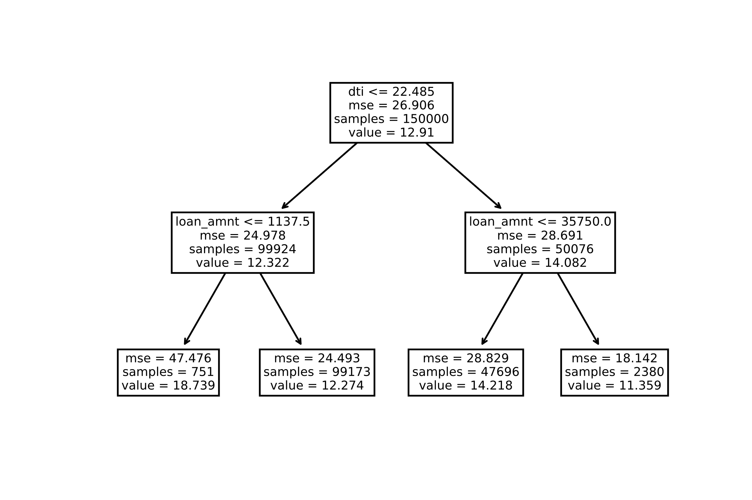
Exercise 1: Decision Tree Regression - Results
Code result
# import packages
from sklearn.tree import DecisionTreeRegressor, plot_tree
from sklearn.metrics import mean_squared_error, r2_score
from sklearn.model_selection import train_test_split
import pandas as pd
# load data set
data = pd.read_csv('dataset_small.csv’)
# fill missing values
data["dti"]=data["dti"].fillna(data["dti"].mean())
# select X and y from data set
y = data['int_rate’]
X = data[['dti','loan_amnt’]]
# get random train and test data from data set
X_train, X_test, y_train, y_test = train_test_split(X, y,
test_size=0.25, random_state=42)
# Configure model
regr = DecisionTreeRegressor(max_depth = 2)
# Fit regression model
regr.fit(X_train, y_train)
# Predict
y_1 = regr.predict(X_test)
# evaluation
mse1 = mean_squared_error(y_test, y_1)
print('DT: mse = '+ str(mse1))
# plot tree
plot_tree(regr, filled = False, feature_names=list(X.columns),
fontsize = 7)
MSE = 25.73871286007019

Slide 23
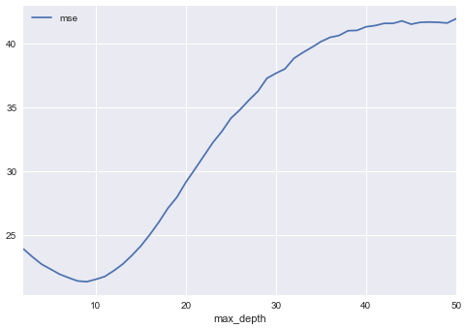
Limitations of Decision Trees
Decision Trees
Advantages:
easy to understand, easy to interpret, and fast to train
Disadvantages:
to capture a complex decision boundary, we need to use large trees which are prone to overfitting and therefore underperform compared to other regression methods
Random Forests overcome problems of Decision Trees with relatively little extra work
Decision Tree using 12 features
from the Lending Club data set

Slide 24
Table of Contents
Decision Trees
Random Forests

Slide 25
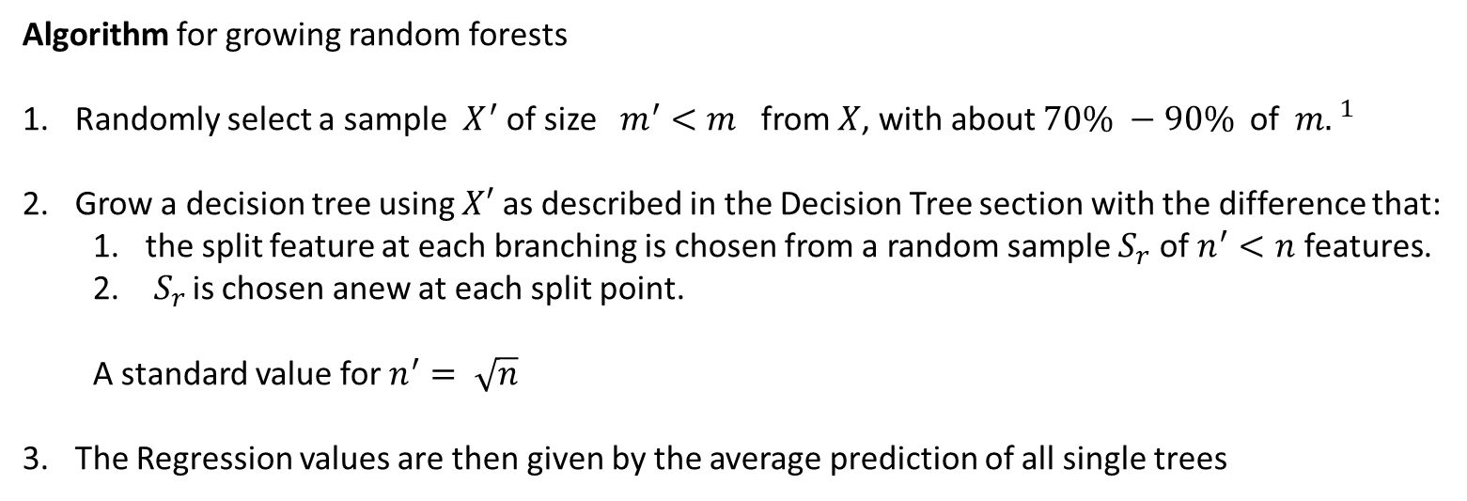
The concept of Random Forests
General idea
Grow a set of roughly independent tree models, which jointly perform better than a single tree model
Algorithm for growing random forests
Randomly select a sample ${ X}^{′}$ of size $m^{′}<m$ from $X$, with about $70\% −90\%$ of ${m. }^{1}$
Grow a decision tree using $X′$ as described in the Decision Tree section with the difference that:
the split feature at each branching is chosen from a random sample $S_{r}$ of $n^{′}<n$ features.
$S_{r }$is chosen anew at each split point.
A standard value for $n^{′}= \sqrt{n}$
The Regression values are then given by the average prediction of all single trees
$a^{1}$Therefore, each tree in the ensemble is built from a sample drawn with replacement
(i.e., a bootstrap sample) from the training set

Slide 26
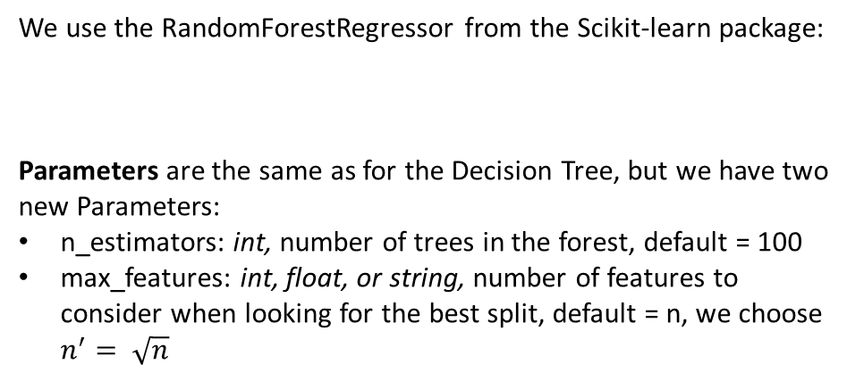
RandomForestRegressor in Python (not complete)
We use the RandomForestRegressor from the Scikit-learn package:
Parameters are the same as for the Decision Tree, but we have two new Parameters:
n_estimators: int, number of trees in the forest, default = 100
max_features: int, float, or string, number of features to consider when looking for the best split, default = n, we choose $n^{′}= \sqrt{n}$
from sklearn.ensemble import RandomForestRegressor
Python example
from sklearn.ensemble import RandomForestRegressor
from sklearn.metrics import mean_squared_error, r2_score
# Data
X_train # training sample (independent variables)
y_train # training sample (dependent variable)
X_test # testing sample (independent variables)
y_test # testing sample (dependent variable)
# Configure model
regr = RandomForestRegressor(max_depth = 2 ,
n_estimators = 10, max_features = ‘sqrt’)
# Fit regression model
regr.fit(X_train, y_train)
# Predict
y_pred = regr.predict(X_test)
# evaluation
mse = mean_squared_error(y_test, y_pred)
r2 = r2_score(y_test, y_pred)
Syntax:
regr = RandomForestRegressor(max_depth = 2,
n_estimators = 10, max_features = ‘sqrt’)
Methods (Same as for Decision Tree):
fit(self, X, y): Build a forest of trees from the training set (X, y), X = training input samples, y = target values, returns the trained model
predict(self, X): Predict regression value for X, X = input samples, returns predicted values based on X

Slide 27
Exercise 2: Random Forest Regression
Use your new knowledge about Random Forests and adjust your code from Exercise 1 to train a Random Forest Regression model
Start with 50 trees in the forest and use the other parameters from Exercise 1
Use different values for max_depth and n_estimators and try to minimize the MSE
Include other features from the data set and try to improve your model
Code skeleton
# import packages
from sklearn.tree import DecisionTreeRegressor, plot_tree
from sklearn.metrics import mean_squared_error, r2_score
from sklearn.model_selection import train_test_split
import pandas as pd
# load data set
data = pd.read_csv('dataset_small.csv’)
# fill missing values
data["dti"]=data["dti"].fillna(data["dti"].mean())
# select X and y from data set
y = ...
X = ...
# get random train and test data from data set
X_train, X_test, y_train, y_test = train_test_split(X, y,
test_size=0.25, random_state=42)
# Configure model
...
# Fit regression model
...
# Predict
...
# evaluation
...
# plot tree
...
Notes:
Dti = A ratio calculated using the borrower’s total monthly debt payments on the total debt obligations, excluding mortgage and the requested LC loan, divided by the borrower’s self-reported monthly income.

Slide 28
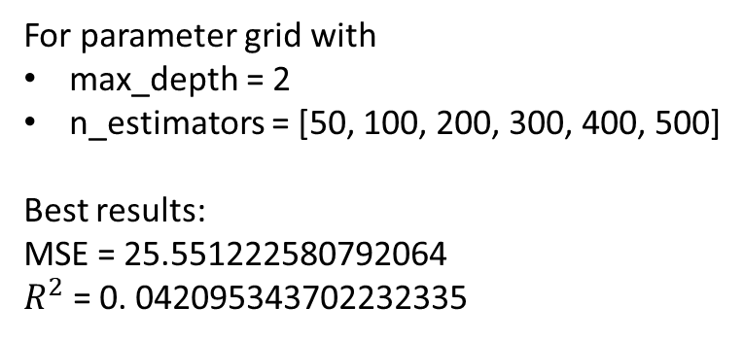
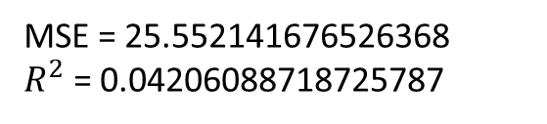
Exercise 2: Random Forest Regression - Results
Code result
# import packages
from sklearn.ensemble import RandomForestRegressor
from sklearn.metrics import mean_squared_error, r2_score
from sklearn.model_selection import train_test_split
import pandas as pd
# load data set
data = pd.read_csv('dataset_small.csv’)
# fill missing values
data["dti"]=data["dti"].fillna(data["dti"].mean())
# select X and y from data set
y = data['int_rate’]
X = data[['dti','loan_amnt’]]
# get random train and test data from data set
X_train, X_test, y_train, y_test = train_test_split(X, y,
test_size=0.25, random_state=42)
# Configure model
regr = RandomForestRegressor(max_depth = 2, n_estimators=50,
max_features='sqrt’)
# Fit regression model
regr.fit(X_train, y_train)
# Predict
y_1 = regr.predict(X_test)
# evaluation
mse1 = mean_squared_error(y_test, y_1)
r2_1 = r2_score(y_test, y_1)
print('RF: mse = '+ str(mse1) + ' r2 = '+ str(r2_1))
MSE = 25.552141676526368
$R^{2}$ = 0.04206088718725787
For parameter grid with
max_depth = 2
n_estimators = [50, 100, 200, 300, 400, 500]
Best results:
MSE = 25.551222580792064
$R^{2}$ = 0. 042095343702232335

Slide 29
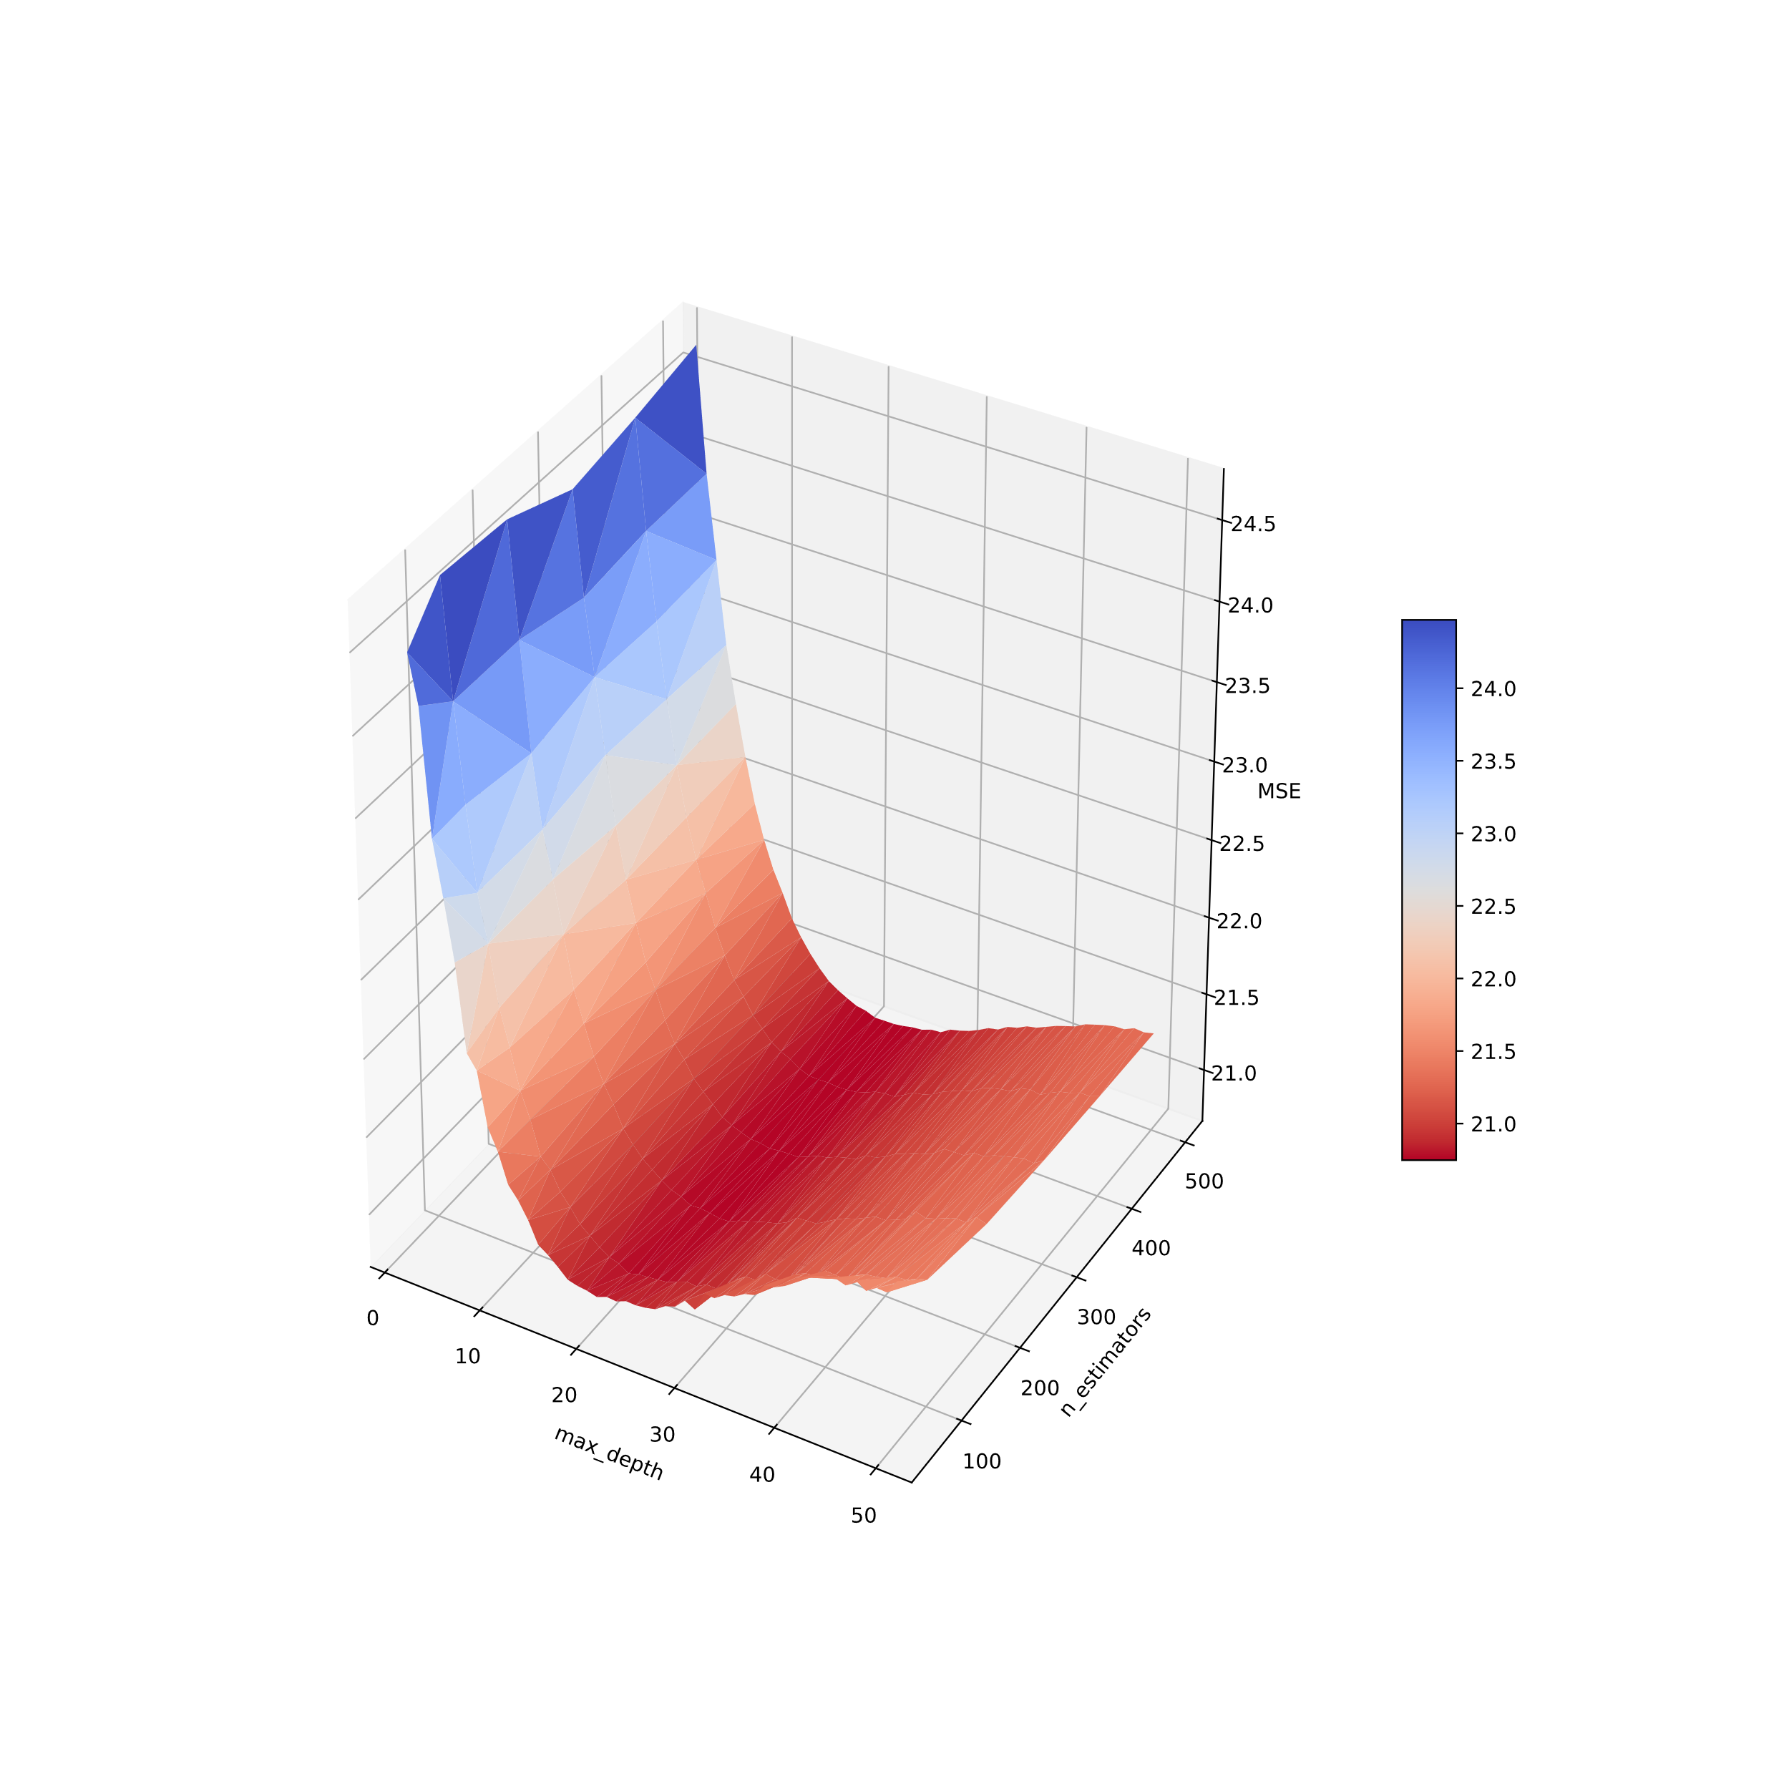
Outlook
Hyperparameter tuning for Decision Tree
optimizing 1 hyperparameter
Hyperparameter tuning for Random Forest optimizing 2 hyperparameters
MSE
Decision Tree using 12 features
from the Lending Club data set
Random Forest using 12 features
from the Lending Club data set
Minimum MSE of 21.3699 at max_depth = 9
Minimum MSE of 20.7431 at max_depth = 21, n_estimators = 500

Slide 30
References
James, G.; Witten, D.; Hastie, T.; Tibshirani, R.: An Introduction to statistical learning with Applications in R. 2013.
Chakraborty, C.; Joseph, A.: Machine learning at central banks. Staff Working Paper No. 674. Bank of England. URL: https://www.bankofengland.co.uk/-/media/boe/files/working-paper/2017/machine-learning-at-central-banks.pdf?la=en&hash=EF5C4AC6E7D7BDC1D68A4BD865EEF3D7EE5D7806
Protopapas, P.; Rader, K.; Dave, R.; Levine, M.: Data Science 1, Lecture #15: Regression Trees & Random Forests. Lecture Notes. URL: https://harvard-iacs.github.io/2017-CS109A/lectures/lecture15/presentation/lecture15_RandomForest.pdf
Scikit learn homepage:
https://scikit-learn.org/stable/modules/tree.html
https://scikit-learn.org/stable/modules/generated/sklearn.tree.DecisionTreeRegressor.html
https://scikit-learn.org/stable/modules/generated/sklearn.tree.export_text.html
https://scikit-learn.org/stable/modules/generated/sklearn.tree.plot_tree.html
https://scikit-learn.org/stable/modules/ensemble.html
https://scikit-learn.org/stable/modules/generated/sklearn.ensemble.RandomForestRegressor.html

